Slide 1

Smart Ticket & Issue Management System
A Modern Java Full-Stack Web Application using Spring Boot & Angular

Slide 2

The Challenge: Bridging the Gap in IT Support
Medium-to-large organizations often grapple with inefficient IT support and customer service operations. Current methods are frequently bottlenecked by outdated practices.
Fragmented Tracking
Reliance on email and spreadsheets for ticket tracking creates silos and inconsistencies.
Limited Visibility
Poor insight into ticket status, priority, and resolution times hinders effective management.
Coordination Chaos
Lack of a centralized system leads to poor coordination between support agents and management.
Insufficient Reporting
Minimal data on SLA compliance and team performance prevents strategic improvements.

Slide 3
Our Vision: A Unified Solution
To revolutionize IT support, we aim to develop a secure, scalable, and modern web-based Ticket & Issue Management System. This system will streamline operations and enhance user experience.
Multi-Role Support
1
Accommodates various user roles with tailored functionalities.
End-to-End Management
2
Manages tickets comprehensively across their entire lifecycle, from creation to closure.
Prioritization & Tracking
3
Enables clear prioritization, escalation, and transparent resolution tracking.
Actionable Insights
4
Provides intuitive dashboards and analytical reports for informed decision-making.
API-Driven & Cloud-Ready
5
Designed for flexibility, integration, and seamless deployment in cloud environments.

Slide 4





PROJECT OBJECTIVE
Crafting a Full-Stack Enterprise Application
This project aims to build a robust Full-Stack Enterprise Application, demonstrating best practices in modern web development.
Spring WebFlux Reactive Backend
Utilizing Spring WebFlux for non-blocking, reactive backend development with high concurrency.
Angular Frontend
Developing a dynamic and responsive user interface with Angular.
JWT Authentication
Implementing robust, token-based security for authentication and authorization.
Layered Architecture
Ensuring a maintainable and modular codebase with clean coding practices.
MongoDB NoSQL Database
Storing data flexibly and scalably with a document-oriented NoSQL database.

Slide 5






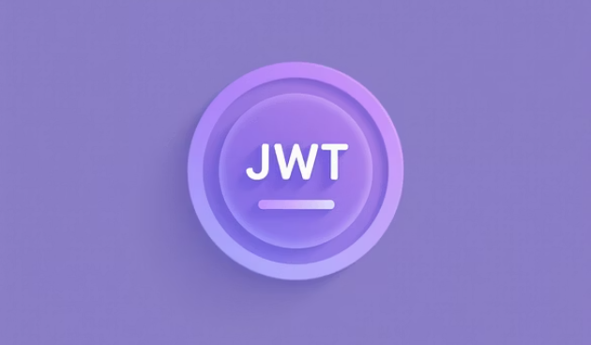
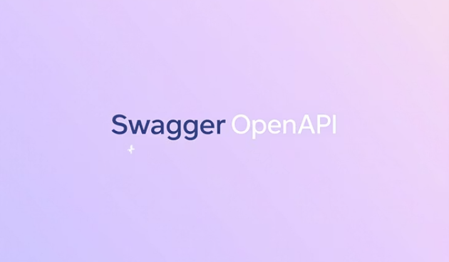




Our Advanced Technology Stack
A comprehensive array of cutting-edge technologies powers our solution, ensuring performance, scalability, and maintainability.
From backend frameworks and frontend libraries to our primary MongoDB database and development tools, each component is selected to deliver a high-quality application.

Slide 6







CORE MODULES
Defining Key System Functionalities
The system is structured around several core modules, each designed to address specific aspects of ticket and user management.
User & Security Management
Ticket Management
Registration, RBAC, JWT, password hashing, and secure API endpoints.
Create, track lifecycle (Created → Assigned → In Progress → Resolved → Closed), reopen, and cancel tickets.
Notifications (Basic)
Assignment & Escalation
Acknowledgments for ticket creation and status change alerts.
Manual/rule-based assignment, priority-based escalation, and SLA breach identification.
Reporting & Dashboards
Communication & Tracking
Visual reports on status, priority, category, SLA compliance, resolution time, and workload.
Internal comments, public responses, and a complete audit trail of ticket activity.

Slide 7
Backend Architecture: A Layered Approach
Our backend follows a robust layered architecture, promoting separation of concerns, scalability, and maintainability.
Reactive Controllers
Handle incoming requests with Mono/Flux streams.
Reactive Services
Contain business logic with reactive operators and orchestration.
Reactive Repositories
Manage data persistence with MongoDB using Spring Data Reactive MongoDB.
Models / DTOs
Define data structures and facilitate data transfer.
Global Exception Handling
Ensures graceful error management across the application.
Configuration
Managed via application.yml for flexible environment settings and WebFlux configuration.

Slide 8





Angular Frontend: Modular & Dynamic
The Angular frontend is built with a modular architecture, ensuring a clean, efficient, and scalable user interface.
Core Module
Shared Module
Handles authentication, interceptors, and guards for application-wide services.
Contains reusable components, directives, and pipes for consistency.
Feature Modules
Forms & Validations
Dedicated modules for Tickets, Admin, and Reports to organize specific functionalities.
Utilizes Template-Driven or Reactive Forms with robust validation rules.

Slide 9
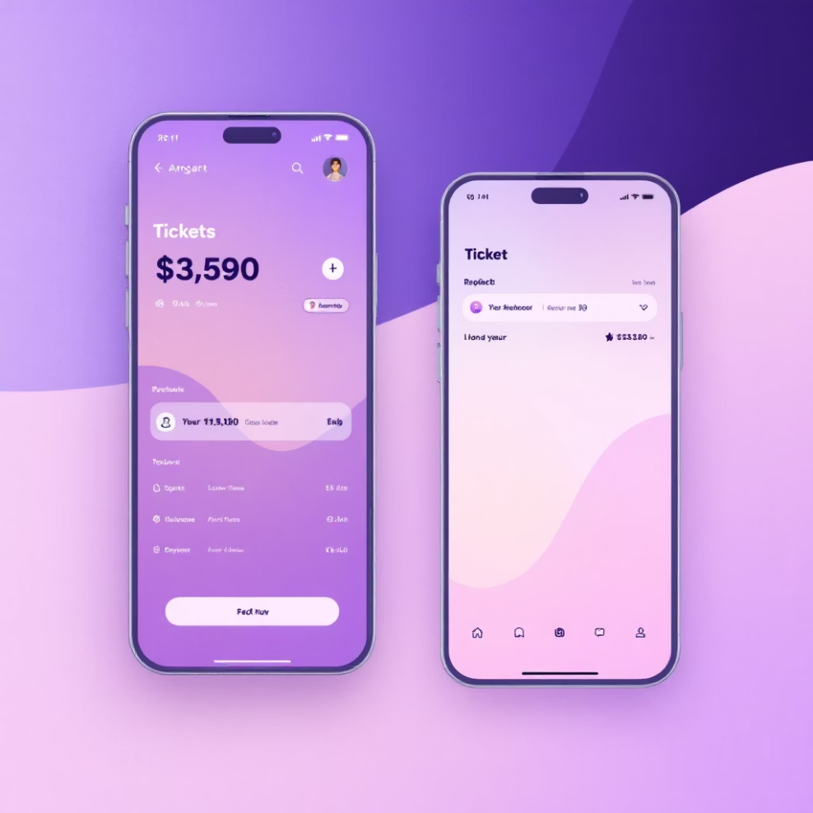
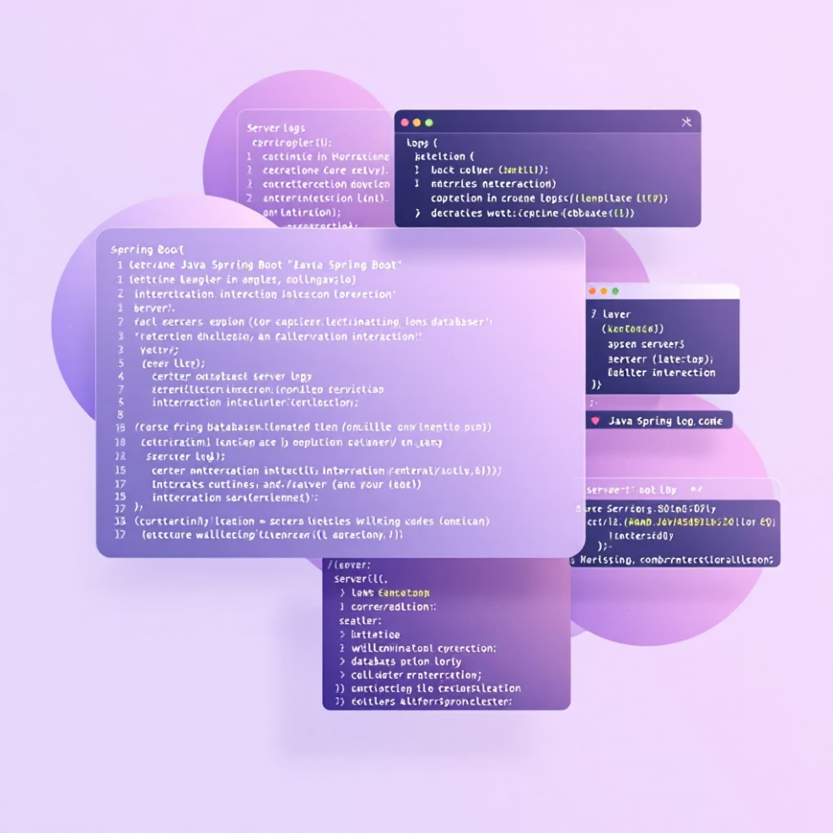
MANDATORY COMPONENTS
Key Requirements for Implementation
Specific functionalities and design principles are mandatory for both Java backend and Angular frontend development, ensuring a comprehensive and high-quality solution.
Java & Backend Usage
Angular Frontend Pages
Reactive Streams: Mono and Flux for non-blocking operations.
Authentication: Login and Register pages.
Dashboards: Comprehensive overview for users.
MongoDB Integration: Spring Data Reactive MongoDB for document-based persistence.
Ticket Management: Create Ticket, My Tickets, Ticket Queue, Ticket Details.
Query Operations: Reactive queries, aggregation pipelines, and custom repository methods.
Reporting: Dedicated reports section.
Validation: Utilizing @Valid and custom validators with reactive flows.
Administration: Admin Panel for system configuration.

Slide 10



Non-Functional & Testing Requirements
Beyond core features, we emphasize critical non-functional attributes and rigorous testing to guarantee a robust, reliable, and deployable system.
RESTful API Design
Ensuring statelessness, client-server separation, and cacheability.
Unit Testing
With JUnit 5 and Mockito for isolated component validation.
Centralized Exception Handling
For consistent error responses and improved debugging.
API Testing
Secure & Scalable Codebase
Using Postman for comprehensive endpoint verification.
Adhering to security best practices and designing for future growth.
Test Cases
Specific scenarios for authentication and CRUD operations.
Environment Configuration
Tailored settings for development and test environments.

Slide 11
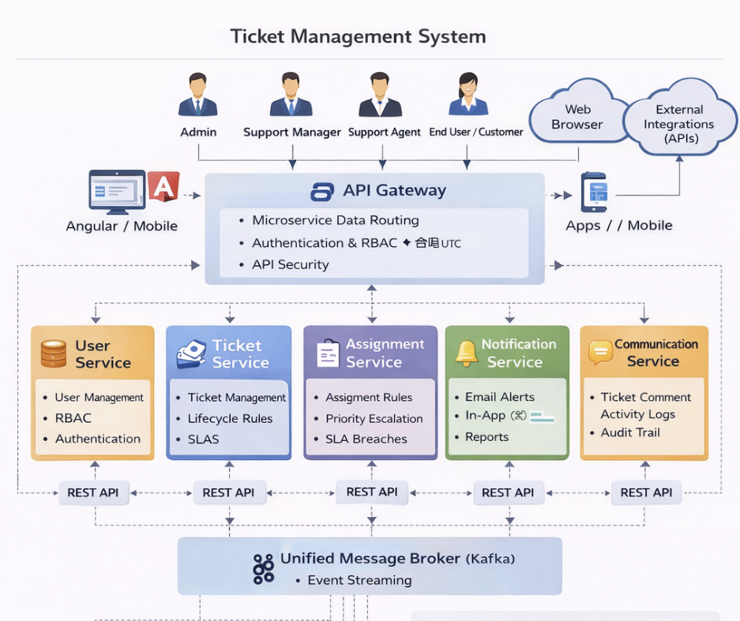

Slide 12
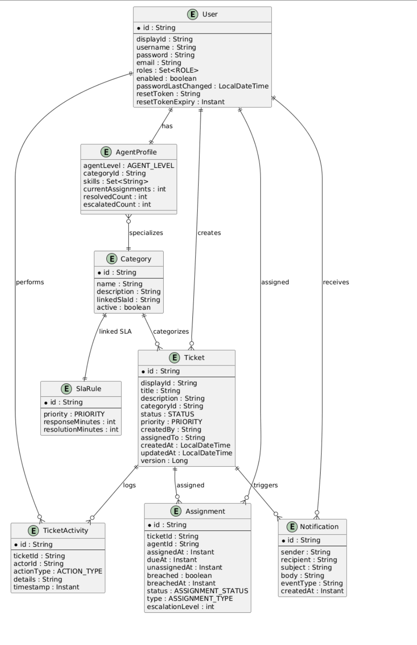

Slide 13
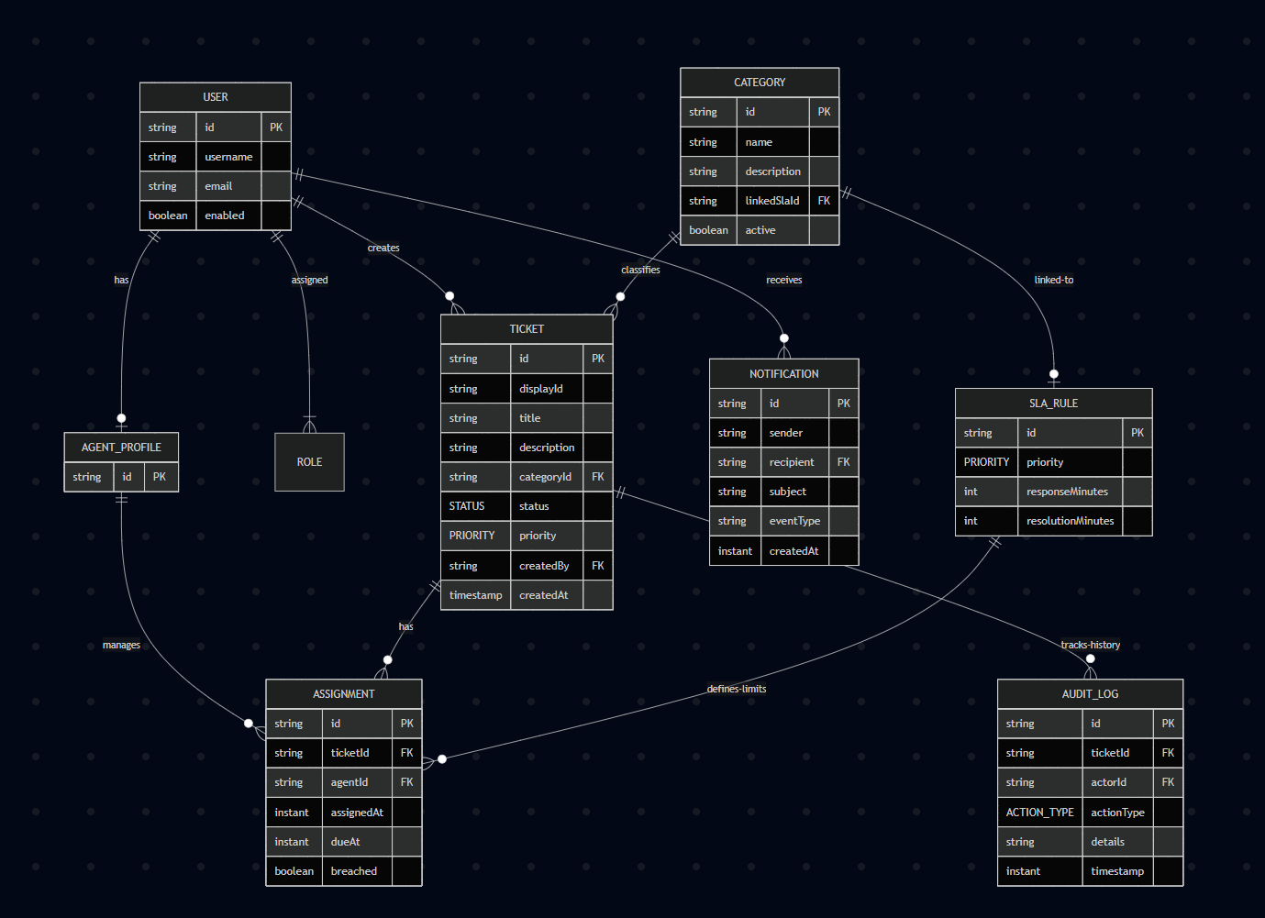
Entity relationship

